Slide 1

Engineering Design | SCT 365-1
Ravana 2.0 Agriculture based Drones
Science and Technology
Uva Wellasa University

Slide 2
Introduction to Drone
A drone is an unmanned aircraft. Drones are more formally known as unmanned aerial vehicles (UAVs)
It is a flying robot that can be remotely controlled or can fly autonomously through software-controlled systems.
It is the future of different sectors in the autonomous industry and in recent years the market value increased up to 10 billion USD.

Slide 3
Industries
Traffic monitoring, Rescue and Surveillance
Agriculture
Existing
Industries
Photography, videography and filmography
Delivery services
Storage and warehouse management
Military and Defense

Slide 4
Drone Mechanism
Vehicle or Platform
The one on which the other parts of drones are mounted.
The airframe
The propulsion system
The flight control computer or system
The precision navigation system
Sense & Avoid System
Payoad
The accessories which give input to the microcontroller is called payloads
Electro-optical Sensing Systems and Scanners
Infra-Red Systems
Radars
Environmental sensors
Control and Navigation
The micro controller and related transceiver systems enables the user to navigate and communicate with the drone.

Slide 5
Drone Agri Industry
$75 Million
In 2016 when the Agri drone industry started

Slide 6
Agriculture Industry
37%
31%
21%
12%
Are not considering using drones
Are considering using
drones
Done will be operate themself
Third party will operate the drone
The market survey was done by DJI drone company with the farmers in the 2018

Slide 7
Drone Usage in Agriculture
To maintain yields, crops require proper fertilization and pesticide application.
Drones equipped with thermal cameras can provide excellent insight into irrigation by highlighting areas that have pooling water or insufficient soil moisture.
Irrigation Management
Crop Dusting and Spraying
Livestock Monitoring
Drones equipped with near-infrared camera sensors allow the drone to see the spectrum of light that plants use to absorb light for photosynthesis
Mapping and Surveying
Drones with thermal imaging cameras allow a single remote pilot in command to monitor livestock.

Slide 8
Features
50 times faster than manual spraying
Full spectral
band capture
Thermal Imaging
Precision mapping

Slide 9
Our Additional Features
Data transfer
Camera based system
Use cloud-based system to transfer data directly to an online portal
Using ML and AI-based Image processing technologies for efficient data collection
Autonomous control system
Mobile Application
Automatic and manual control system with hybrid embedded system
Using a mobile application to control and navigate the drone and to explore settings

Slide 10
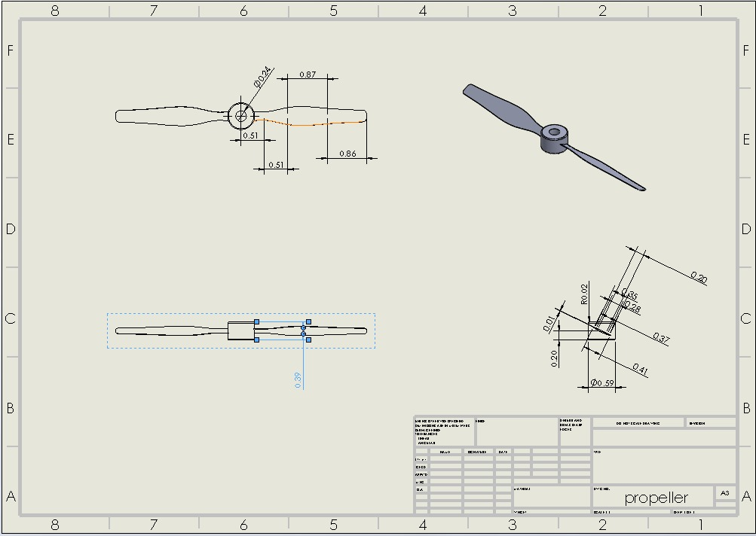
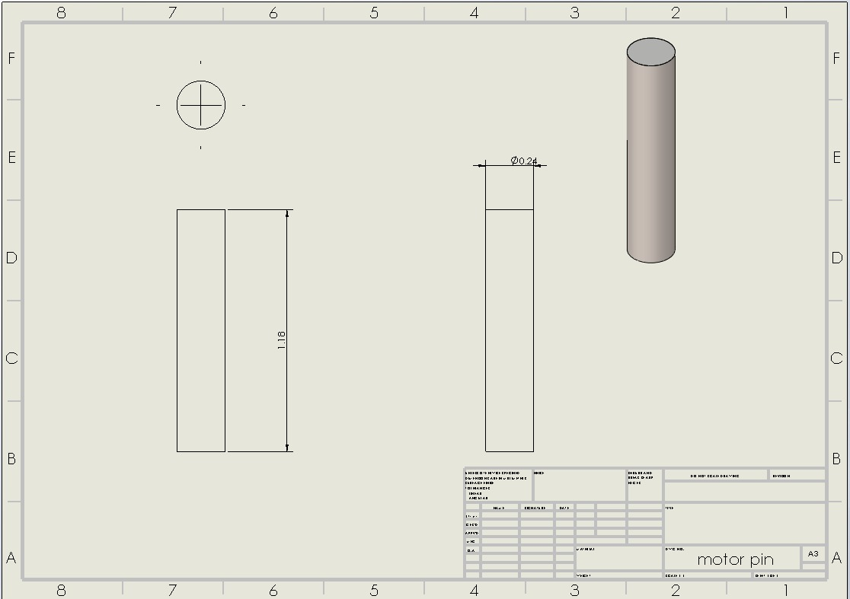
Design - Drawing
Propeller
Motor Pin

Slide 11
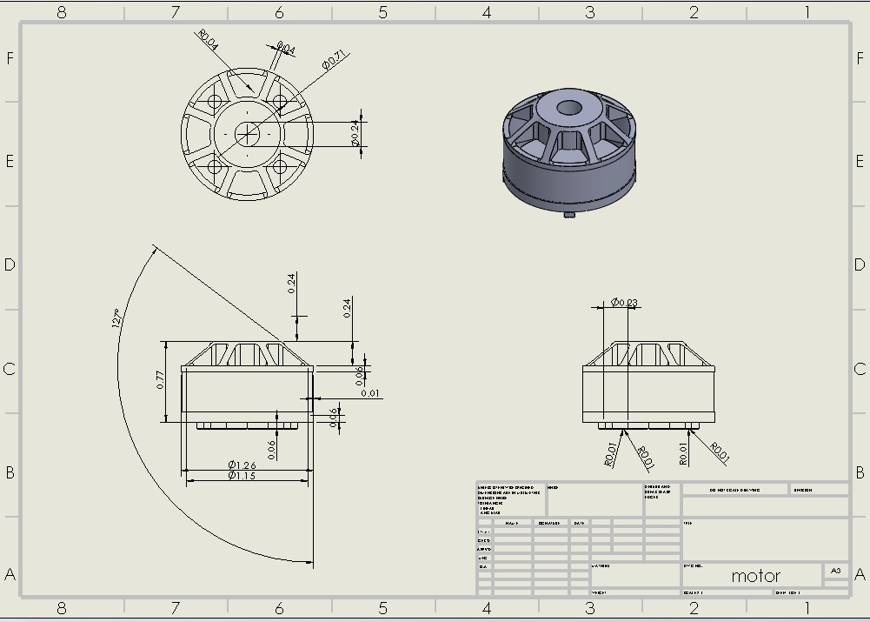
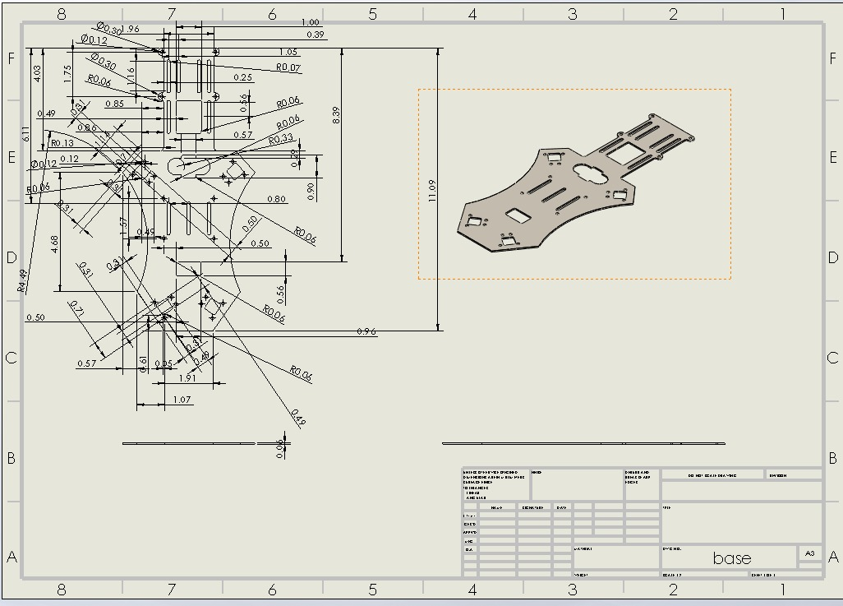
Design - Drawing
Motor
Base

Slide 12
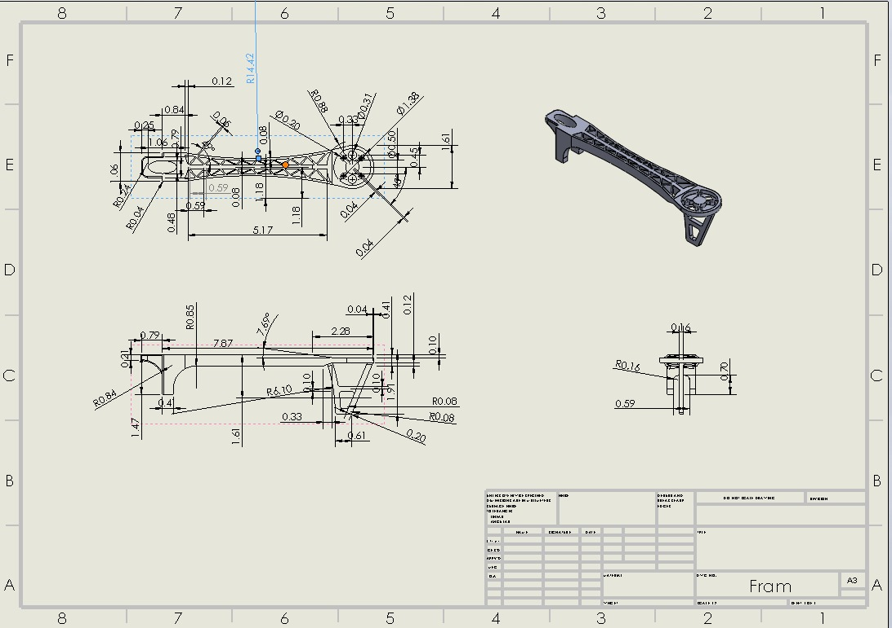
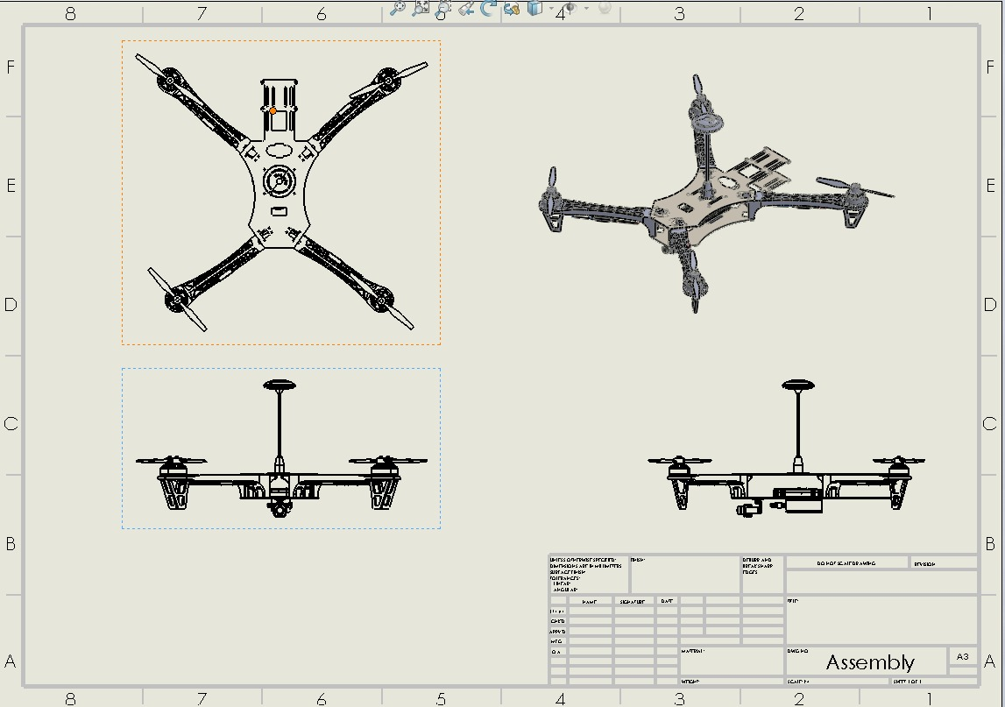
Design - Drawing
Frame
Assembly

Slide 13
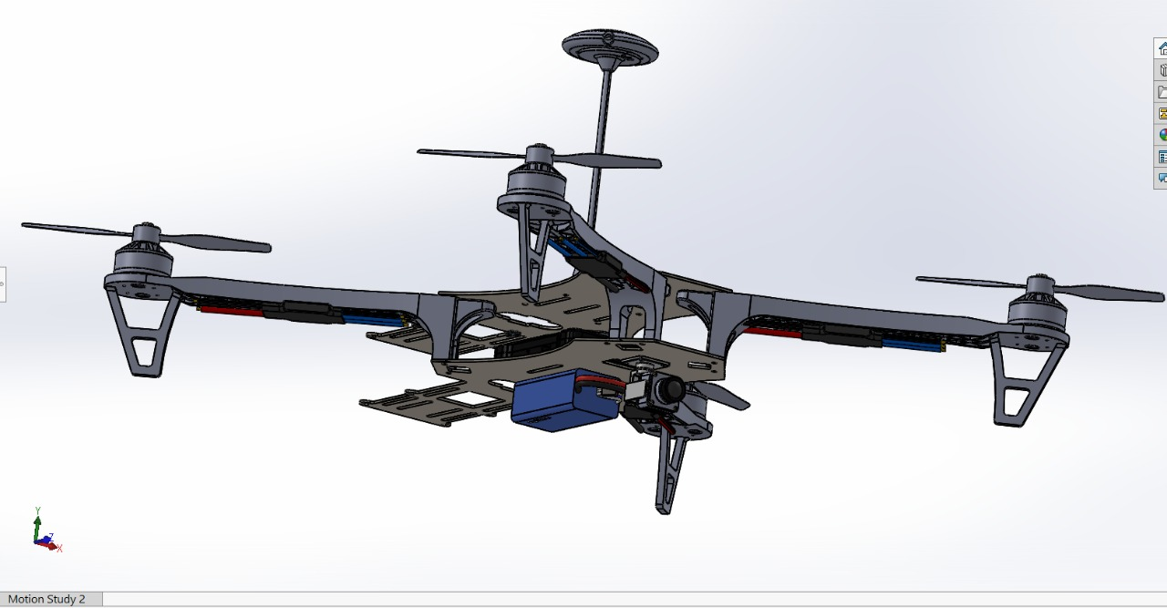
Design - Model
3D Model - Assembly

Slide 14
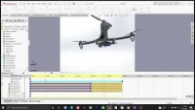
Design - Model
Simulation

Slide 15



Our Team
Jayanthan Amalanatan
Janushan Rathikumar
L.A.M.G.Saumya
UWU/SCT/18/046
UWU/SCT/18/039
UWU/SCT/18/042
Thank-You

